Slide 1
BugNet, 12.12.2018,
Getting started with microservices
Docker & Kubernetes

Slide 2
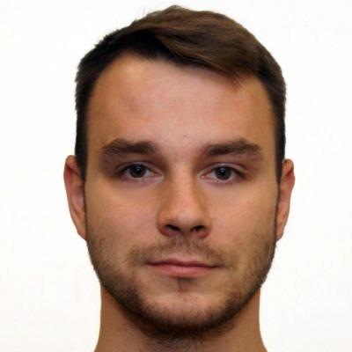

introduction of presenter
↓ | Paweł Ruciński
 | Software Developer, Gdańsk Bydgoszcz, CC Digital Backend developer focused on a cloud based architecture Working for Sii since May, prucinski@pl.sii.eu, pawel.rucinski90@gmail.com
PAWEŁ FROM SII GDAŃSK

Slide 3

What are microservices?
Microservices - also known as the microservice architecture - is an approach to developing a single application as a suite of small services, each running in its own process and communicating with lightweight mechanisms, often an HTTP resource API. These services are built around business capabilities and independently deployable by fully automated deployment machinery. There is a bare minimum of centralized management of these services, which may be written in different programming languages and use different data storage technologies.
Source: martinfowler.com
Notes:
3

Slide 4
Presentation objectives
Docker,
Kubernetes,
Azure
Notes:
4

Slide 5
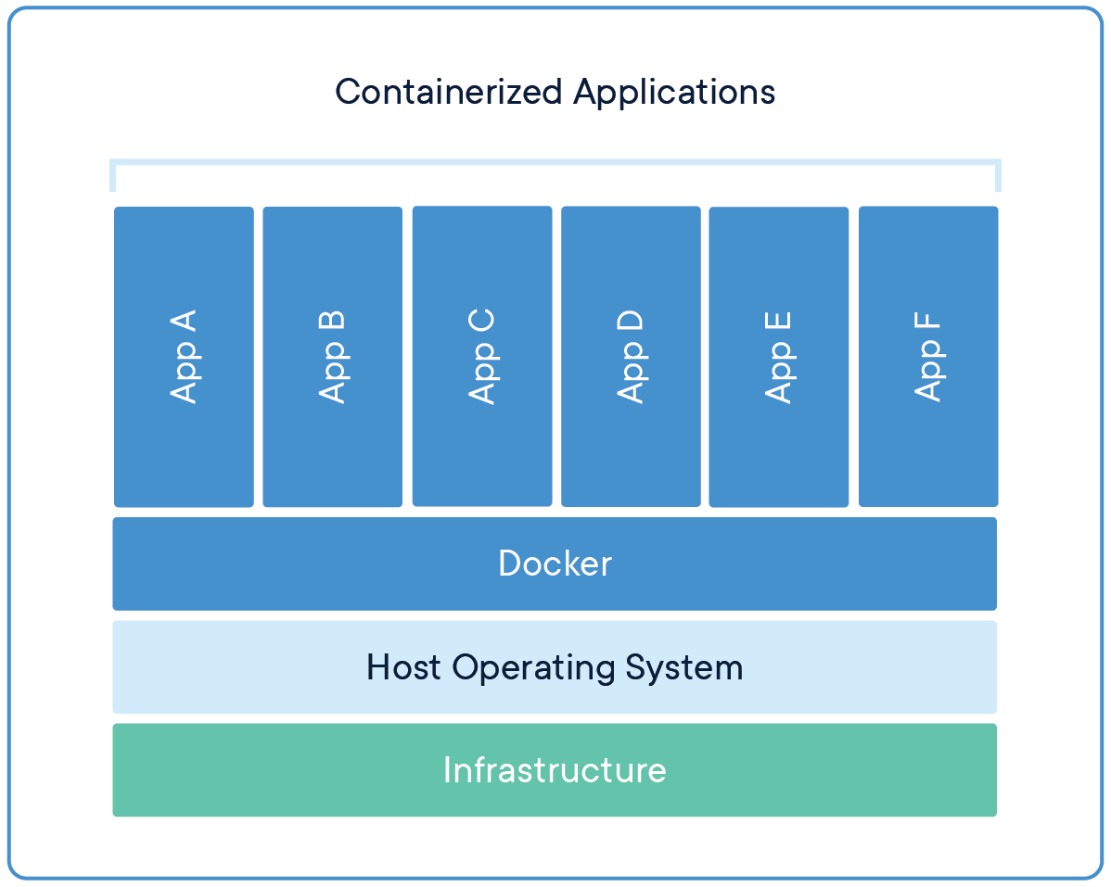
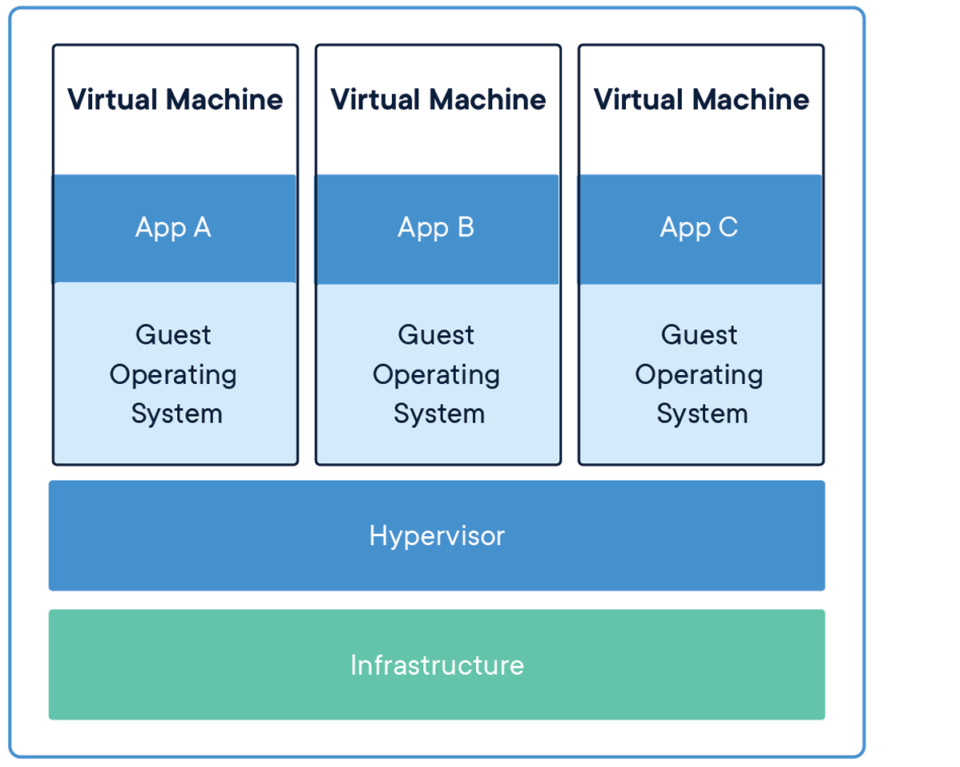
Docker
Docker is a computer program that performs operating-system-level virtualization, also known as "containerization".
Source: Wikipedia.org
Source: Docker.com
Notes:
5

Slide 6
Main docker objects
Image
Container
Registry
Notes:
6

Slide 7

Docker Presentation

Slide 8
Kubernetes
Kubernetes is a portable, extensible open-source platform for managing containerized workloads and services, that facilitates both declarative configuration and automation. Source: kubernetes.io
Notes:
8

Slide 9
Kubernetes
Pod
Controllers:
ReplicationController
Deployments
StatefulSets
…
Services
…
Notes:
9

Slide 10
Kubernetes Presentation

Slide 11
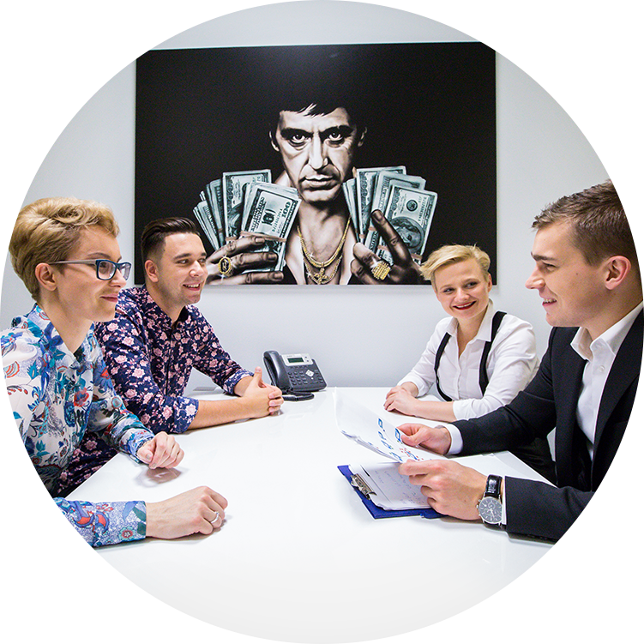
Time to take it on your own
Helpful links:
https://docs.docker.com/get-started/
https://docs.microsoft.com/en-us/azure/container-instances/
https://docs.microsoft.com/en-us/azure/container-registry/
https://kubernetes.io/docs/user-journeys/users/application-developer/foundational/
https://docs.microsoft.com/en-us/azure/aks/

Slide 12
Keep in touch
Presentation resources:
https://github.com/meanin/getting-started-with-microservices/
Linked.in:
https://www.linkedin.com/in/meanin/
Contact:
prucinski@pl.sii.eu
pawel.rucinski90@gmail.com

Slide 13


